Slide 1



NERVCON
BCI Gaming made easy
Nervcon Team 63
Michele Romani, Martin Walchshofer, Leo Schreiner, Enes Arslan, Bernard Wong

Slide 2
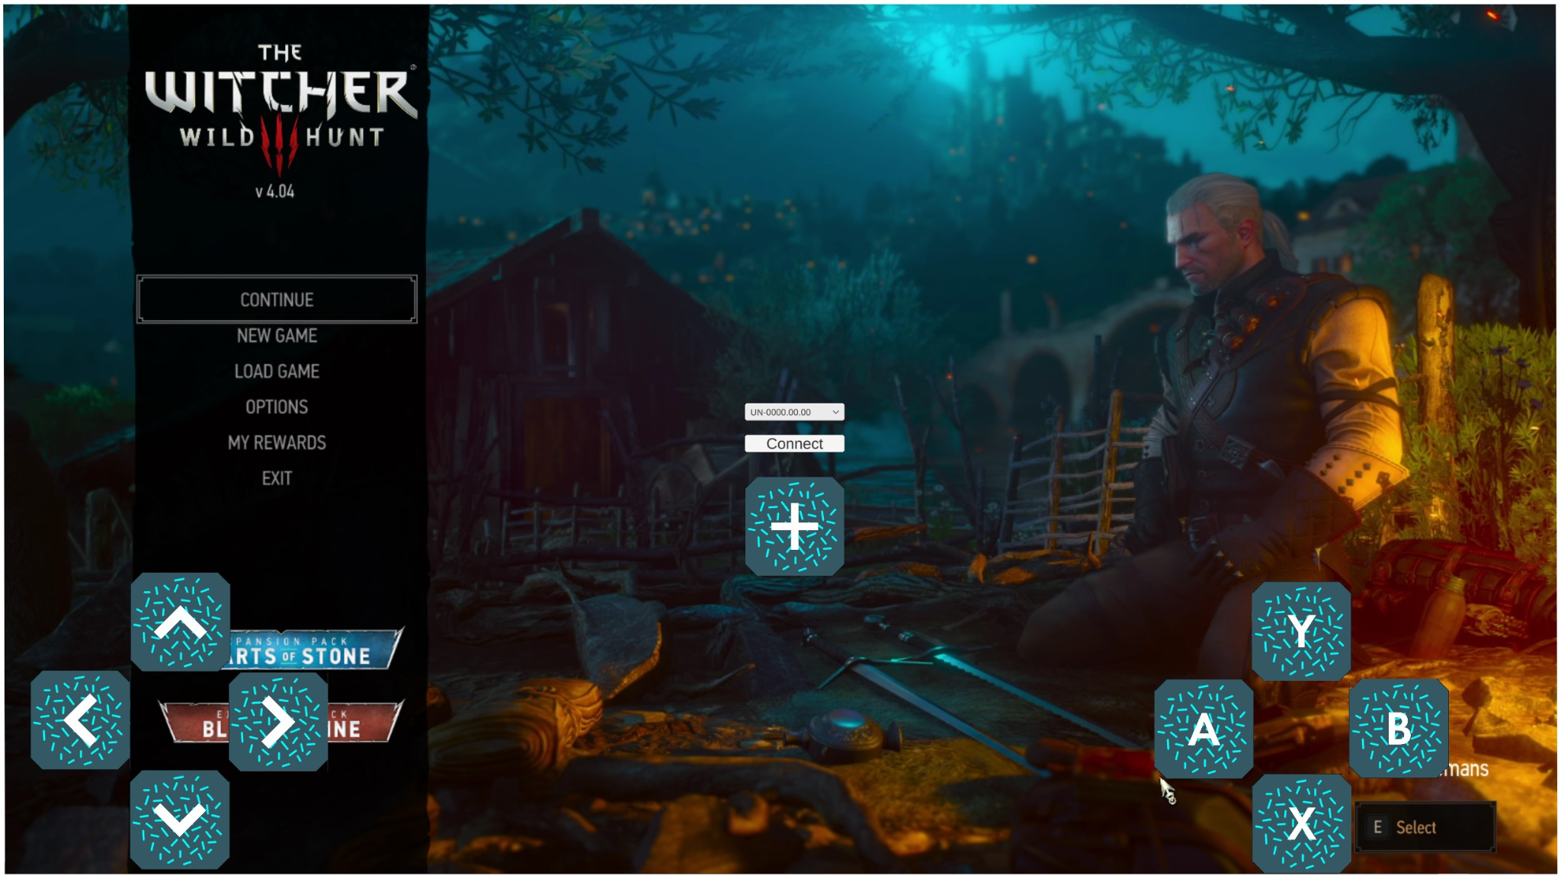
The Problem: BCI games are mostly built from the BCI perspective and just for one use-case
We want to make BCI technology an integral part of the games you already love!

Slide 3
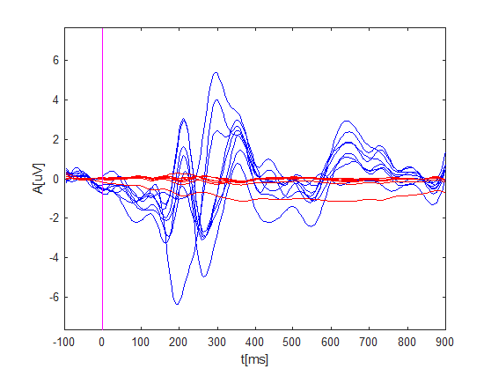
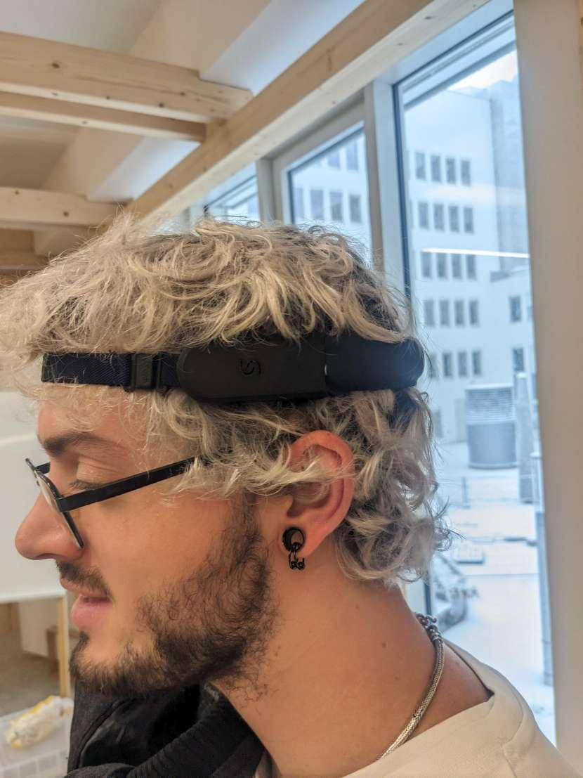
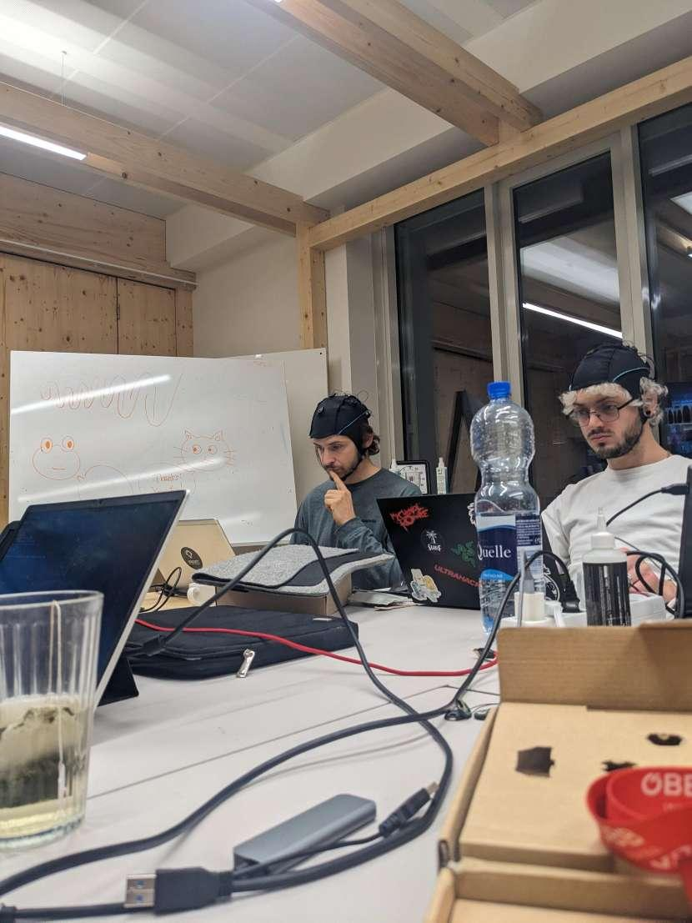
The Solution:
BCI Controller Overlay
Device: Unicorn
Calibration: 30 seconds
Selection: up to 30 classes
VEPs

Slide 4
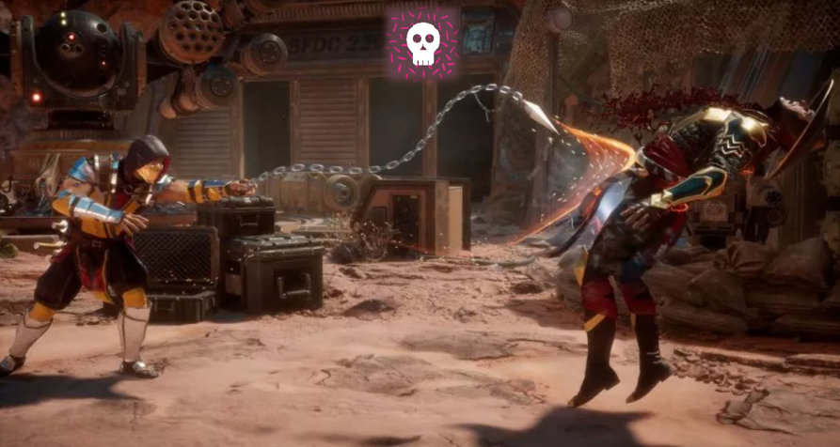

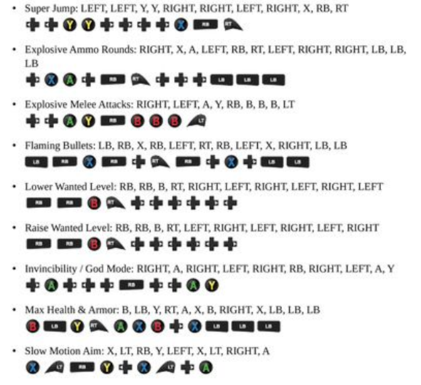
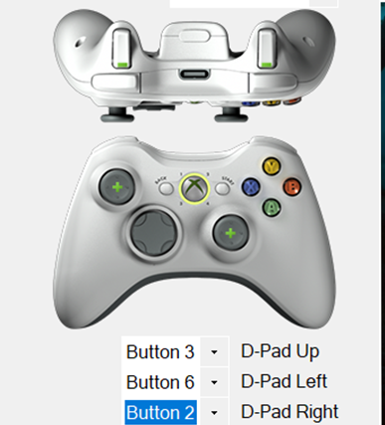
STANDARD BUTTONS
SPECIAL COMBOS
CHEAT CODES
AND MORE

Slide 5
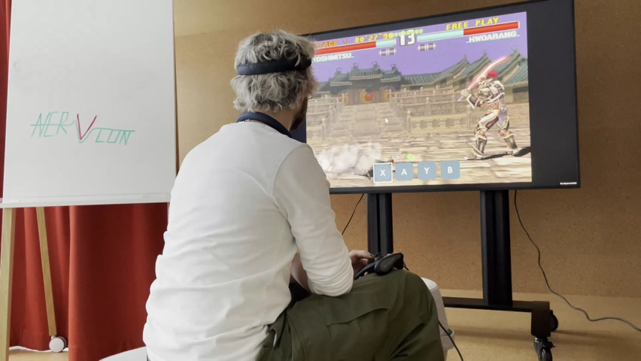
Our favourite Tekken 3 and many other mechanics

Slide 6
Documentation
https://github.com/unicorn-bi/NervCon

